Slide 1

Capturing the Beat of America: A Comprehensive Study of Music Genres
Amara Henry, Christina LaManna, Matthew Henry, Ifeanyi Ezugwu

Slide 2
Project description
This project aims to provide a comprehensive analysis of music genre popularity in 2022, identify the most influential artists within each popular genre during this period, and examine how certain demographics impact the distribution of music preferences.
Research questions
What are the three most popular genres of music in 2022?
What artist affected each genre the most in that year?
How does demographics affect the popularity of those genres?

Slide 3
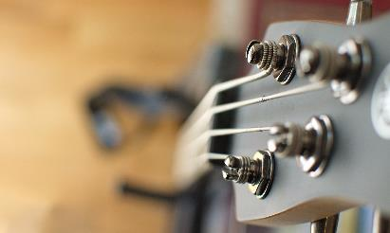


Data sources used
STATISTA
DEVELOPER.SPOTIFY.COM
KAGGLE

Slide 4
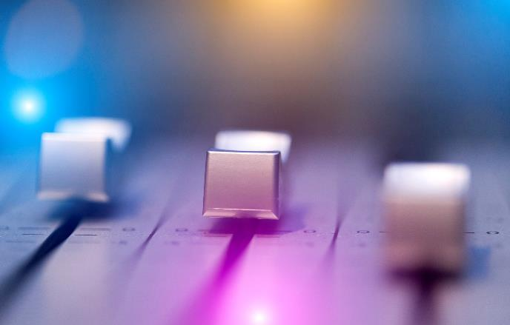

Question #1
What are the three most popular genres of music in 2022?

Slide 5
Most popular genres

Slide 6
Most popular genres

Slide 7

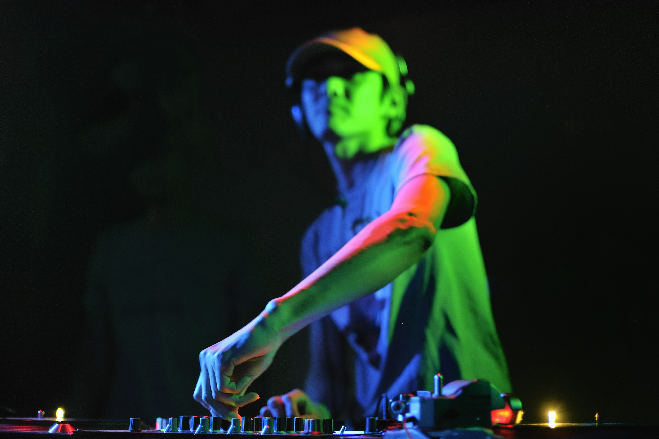
Question #2
What artist affected each genre the most in that year?

Slide 8
#1 Artists in genres

Slide 9


Question #3
How do demographics affect the popularity of those genres?

Slide 10
Demographics impact

Slide 11




Most
With PowerPoint, you can create presentations and share your work with others, wherever they are. Type the text you want here to get started. You can also add images, art, and videos on this template. Save to OneDrive and access your presentations from your computer, tablet, or phone.

Slide 12
table
 | Category 1 | Category 2 | Category 3 | Category 4
Item 1 | 4.5 | 2.3 | 1.7 | 5
Item 2 | 3.2 | 5.1 | 4.4 | 3
Item 3 | 2.1 | 1.7 | 2.5 | 2.8
Item 4 | 4.5 | 2.2 | 1.7 | 7

Slide 13

The way to get started is to quit talking and begin doing.
Walt Disney

Slide 14
timeline
Title
To start a presentation, go to the Slide Show tab, and select From Beginning.
Title
To display Presenter view, in Slide Show view, on the control bar at the bottom left select the three dots, and then Show Presenter View.
Title
During your presentation, the speaker notes are visible on your monitor, but aren't visible to the audience.
Title
Title
The Notes pane is a box that appears below each slide. Tap it to add notes.
If you don’t see the Notes pane or it is completely minimized, click Notes on the task bar across the bottom of the PowerPoint window.

Slide 15
content
Subtitle
Subtitle
Add text, images, art, and videos.
Add transitions, animations, and motion.
Save to One Drive, to get to your presentations from your computer, tablet, or phone.
Add text, images, art, and videos.
Add transitions, animations, and motion.
Add text, images, art, and videos.
Add transitions, animations, and motion.
Save to One Drive, to get to your presentations from your computer, tablet, or phone.
Add text, images, art, and videos.
Add transitions, animations, and motion.

Slide 16
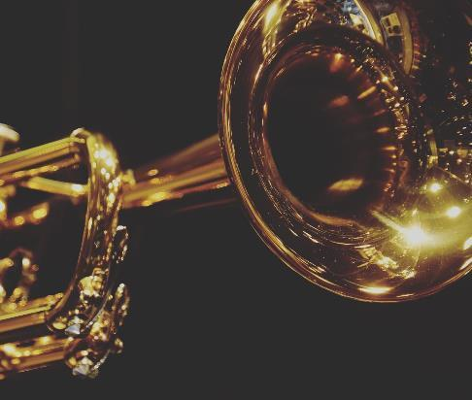
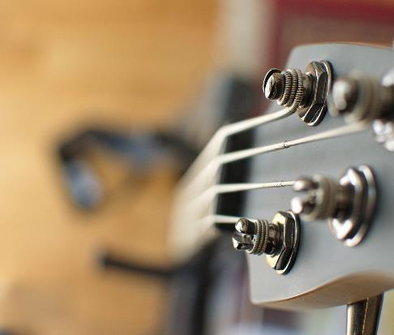
Summary
With PowerPoint, you can create presentations and share your work with others, wherever they are. Type the text you want here to get started. You can also add images, art, and videos on this template. Save to OneDrive and access your presentations from your computer, tablet, or phone.

Slide 17

Thank you
GITHUB:
https://github.com/cnlamanna/Project-1

